Slide 1

Networking
RIP configuration & OSPF configuration
俞燕 202192455057
郑爽 202192455055
李睿琦 202192455056
张瑞恒 202192455054
SAIB MD 202169990073
演示文稿是一种实用的工具，可以是演示，演讲，报告等

Slide 2
C O N T E N T S
1
2
3
4
RIP
OSPF
RIP vs. OSPF
REFERENCES

Slide 3
01
RIP

Slide 4
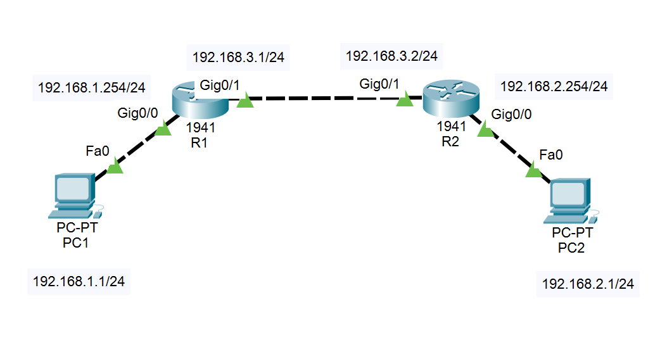
Network topology
Experiment devices(for the example): 2 PCs, 2 Router1941s, 3 Copper Cross-Overs

Slide 5
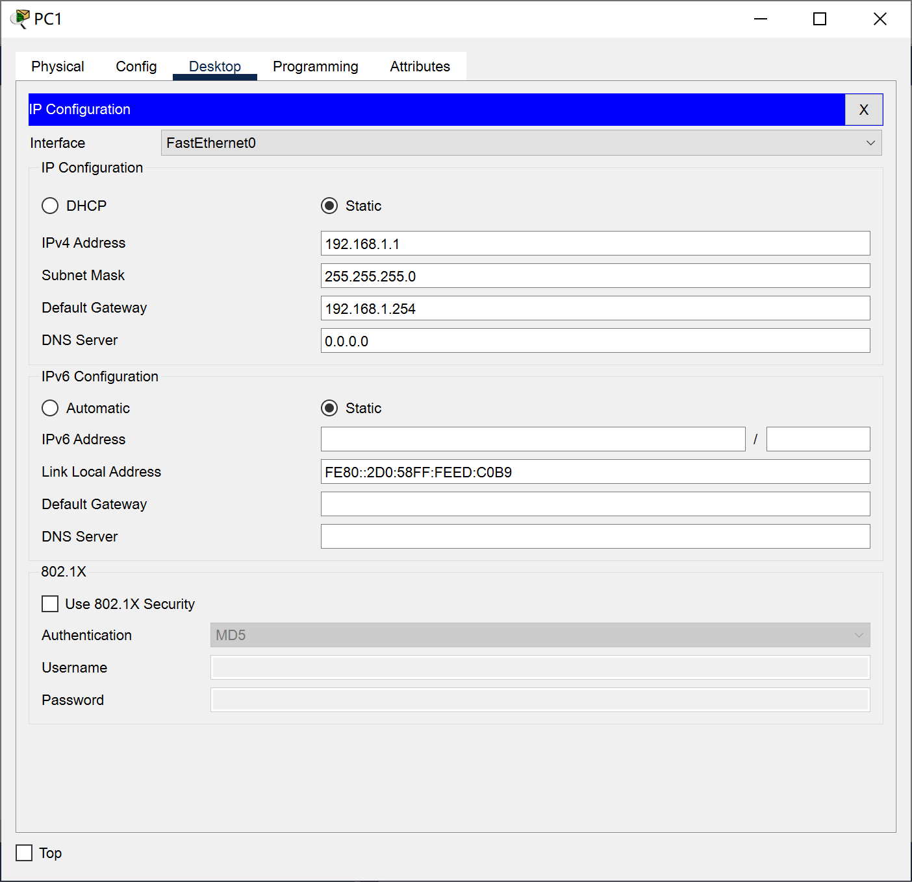
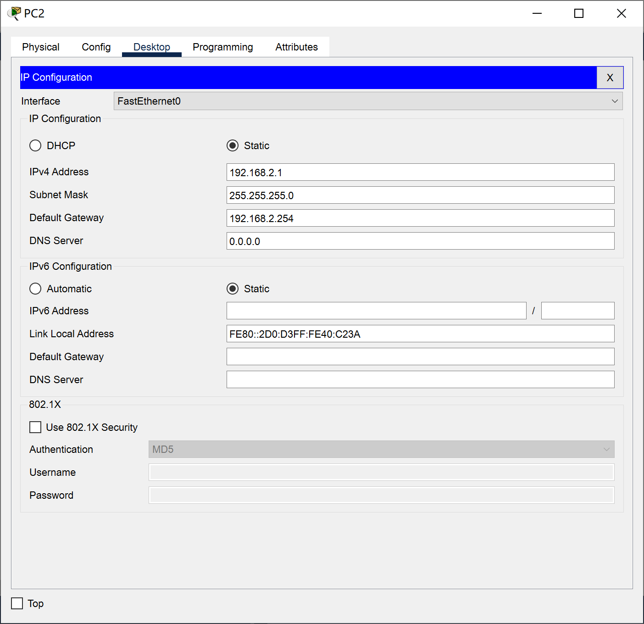
PC Setup
IP address, subnet mask, default gateway

Slide 6
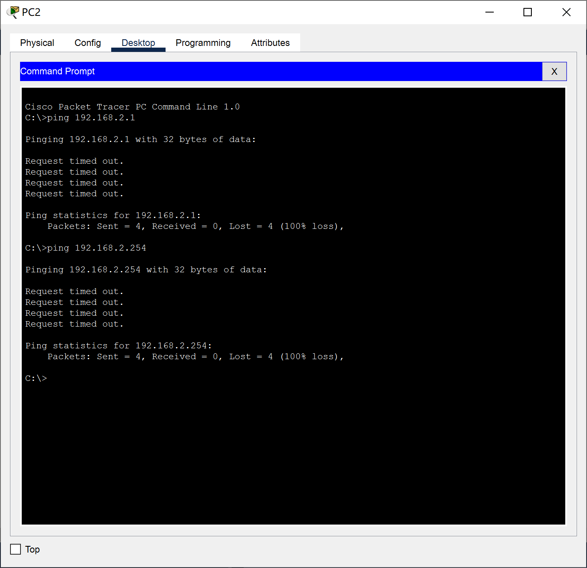
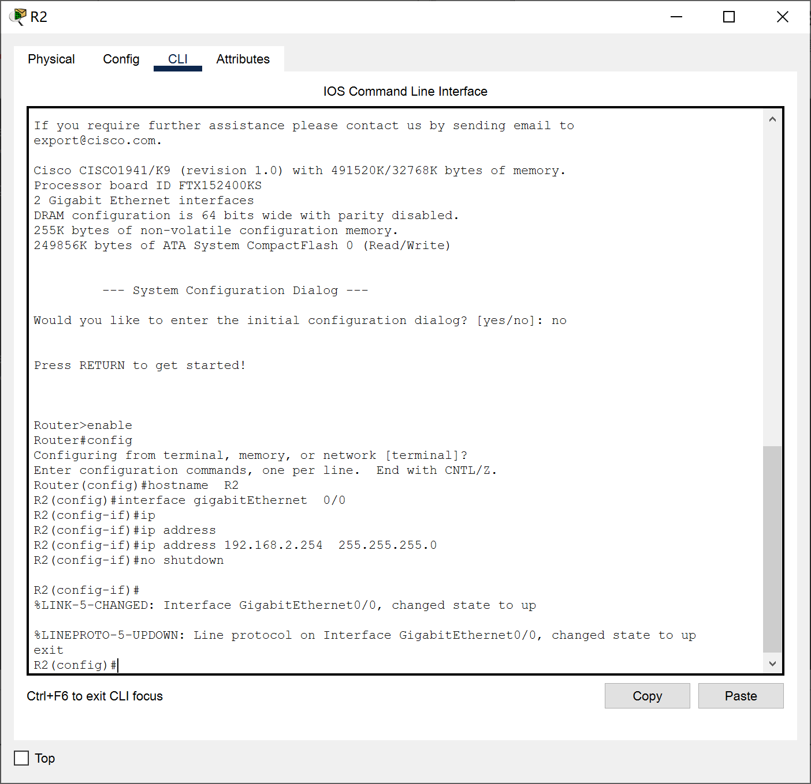
Router Basic Setup
Set up R2 interface(R1 is similar to R2)
Firstly, input “en”
Test PC2, R2 for connectivity

Slide 7
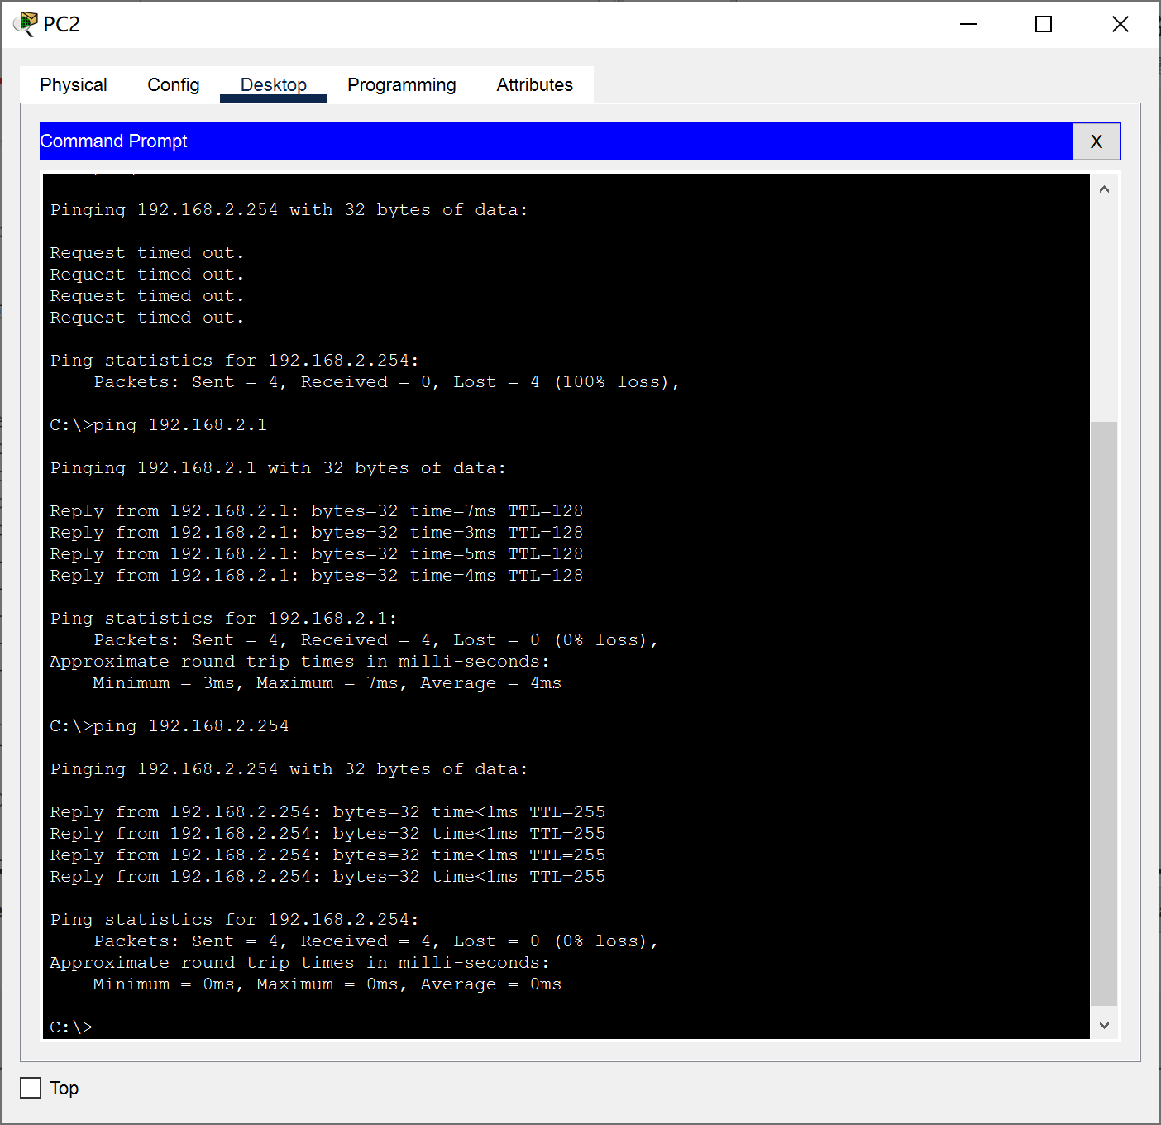
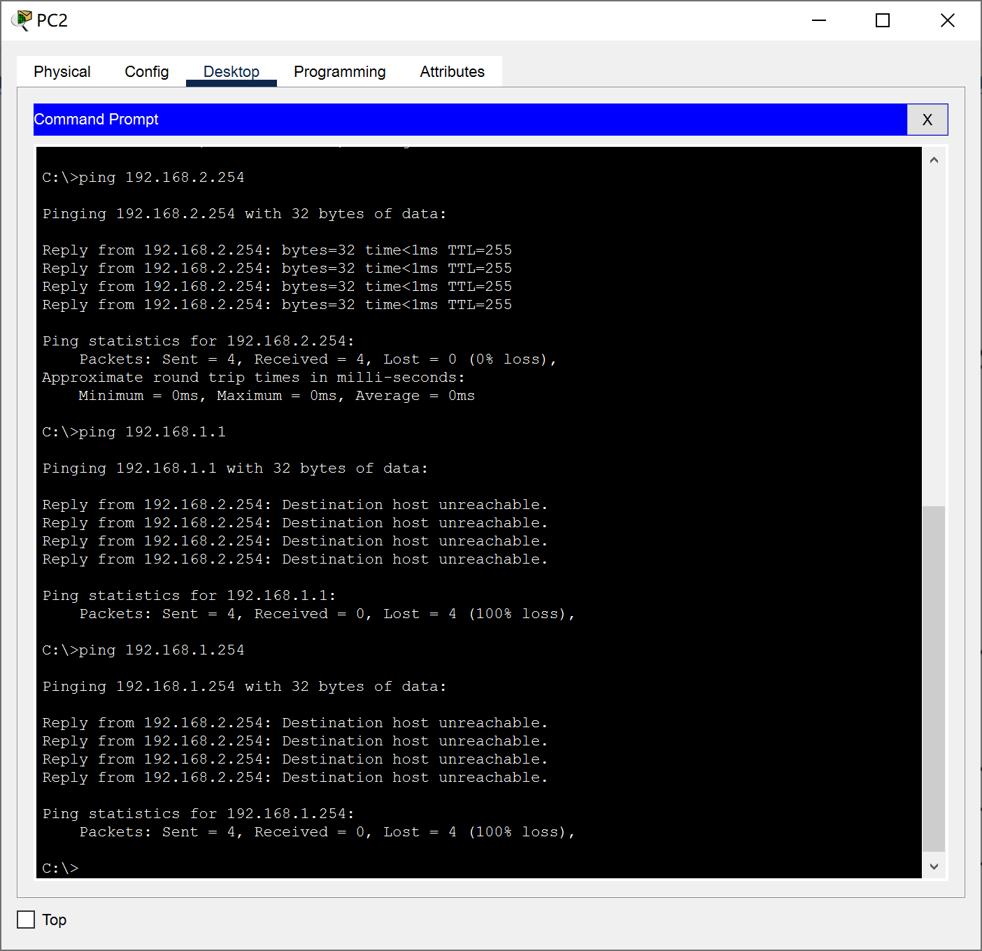
Router Basic Setup
After setting up R1 and R2
PC1 and R1 is still unreachable for PC2 and R2

Slide 8
Router Basic Setup
Set up router interface and open
R1
interface gigabitEthernet 0/1 ip address 192.168.3.1 255.255.255.0
no shutdown
exit
R2
interface gigabitEthernet 0/1 ip address 192.168.3.2 255.255.255.0
no shutdown
exit

Slide 9
Router Basic Setup
Set up RIP
R1
router rip
network 192.168.1.0
network 192.168.3.0
version 2
no auto-summary
R2
router rip
network 192.168.3.0
network 192.168.2.0
version 2
no auto-summary

Slide 10
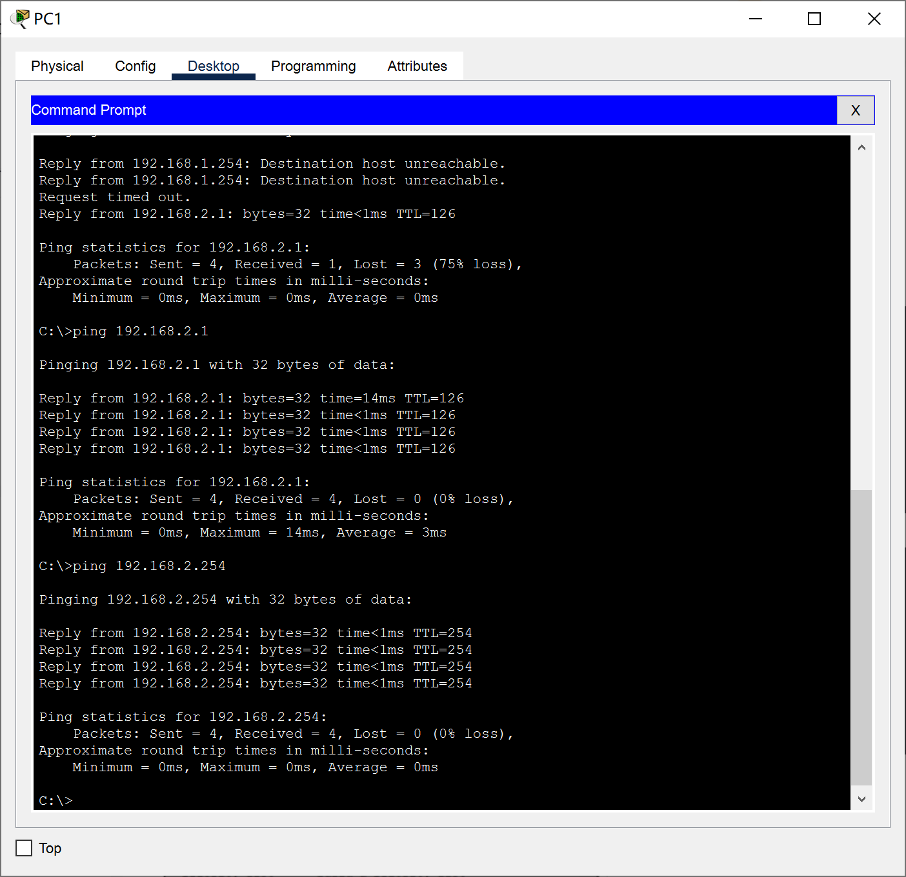
Test

Slide 11
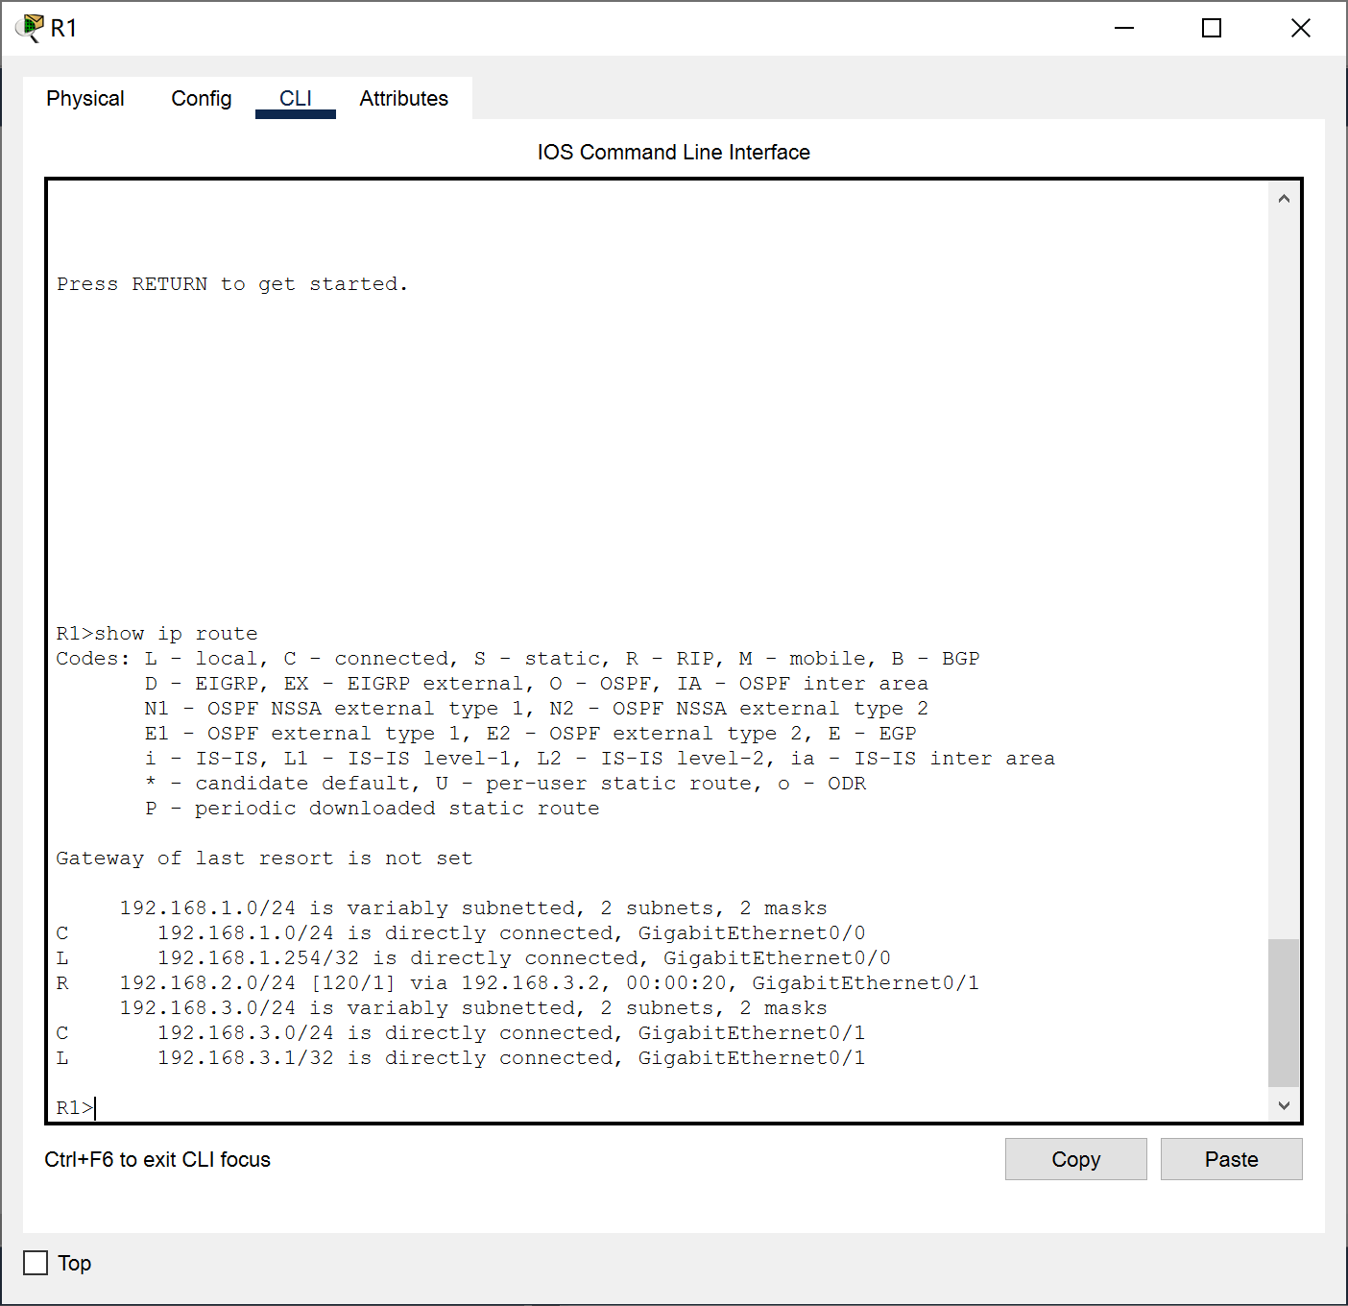
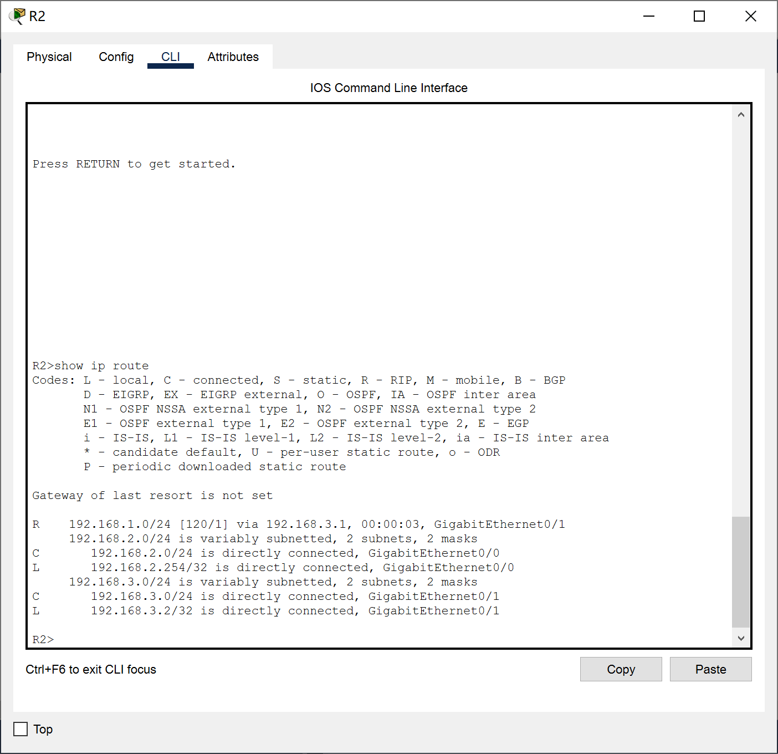
Routing Table

Slide 12
Routing Table
R1 and R2 use the RIP protocol for route learning.
In the routing table, C represents a directly connected route, indicating that the network is directly connected to the interface on the router. R represents a RIP route, indicating a route learned through the RIP protocol.

Slide 13
R1:Routing Table
The learned routes include the following:
a. Destination network 192.168.1.0/24, learned through a direct connection to the GigabitEthernet0/0 interface (C).
b. Destination network 192.168.2.0/24, learned through the next hop 192.168.3.2 (R), hop count is 120, last update time is 00:00:20, and the interface is GigabitEthernet0/1.
c. Destination network 192.168.3.0/24, learned through a direct connection to the GigabitEthernet0/1 interface (C).

Slide 14
R2:Routing Table
The learned routes include the following:
a. Destination network 192.168.2.0/24, learned through a direct connection to the GigabitEthernet0/0 interface (C).
b. Destination network 192.168.1.0/24, learned through the next hop 192.168.3.1 (R), hop count is 120, last update time is 00:00:03, and the interface is GigabitEthernet0/1.
c. Destination network 192.168.3.0/24, learned through a direct connection to the GigabitEthernet0/1 interface (C).

Slide 15
02
OSPF

Slide 16
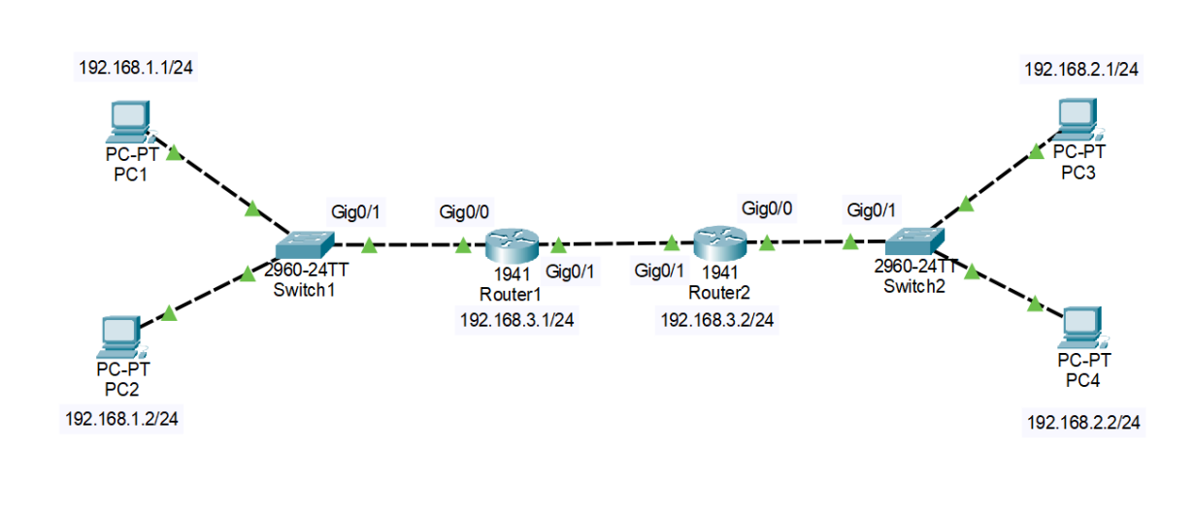
Network topology
Experiment devices : 4 PCs, 2 Router, 2 Switches

Slide 17
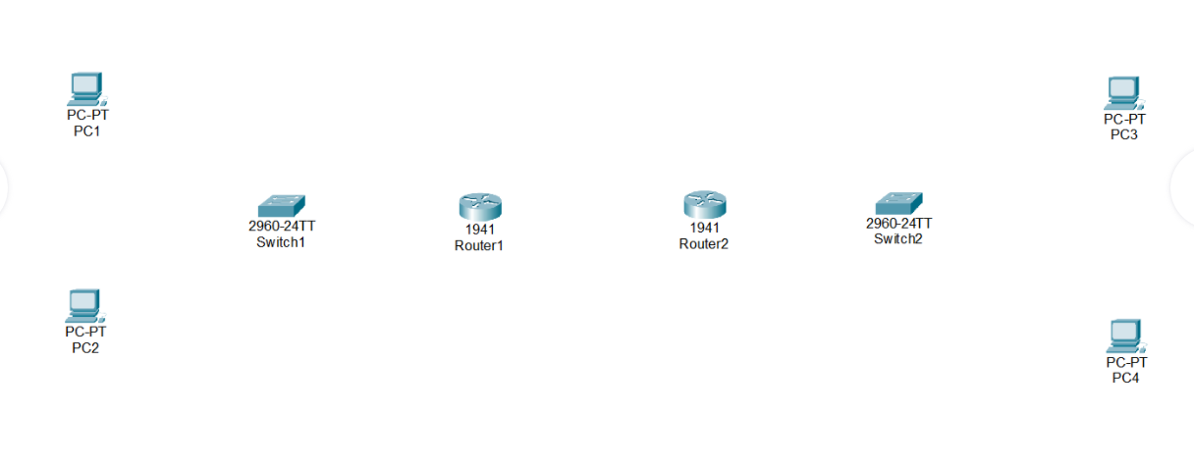
Network topology
Place the PC, Switchh and Router

Slide 18
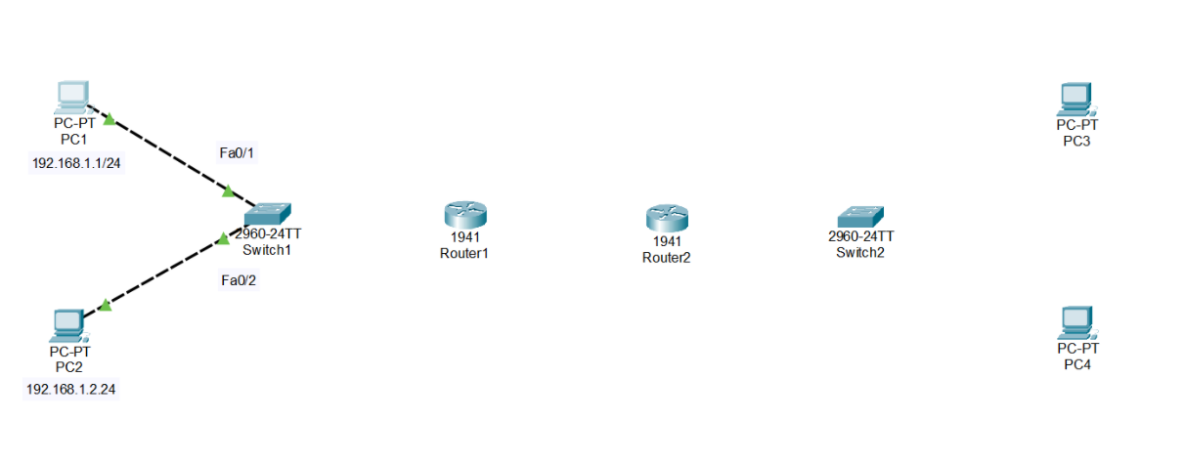
PC Setup
PC1 and PC2 are connected through the switch.
The ip of PC1 and PC2 are configured as 192.168.1.1 and 192.168.1.2 respectively, and the default gateway is 192.168.1.254

Slide 19
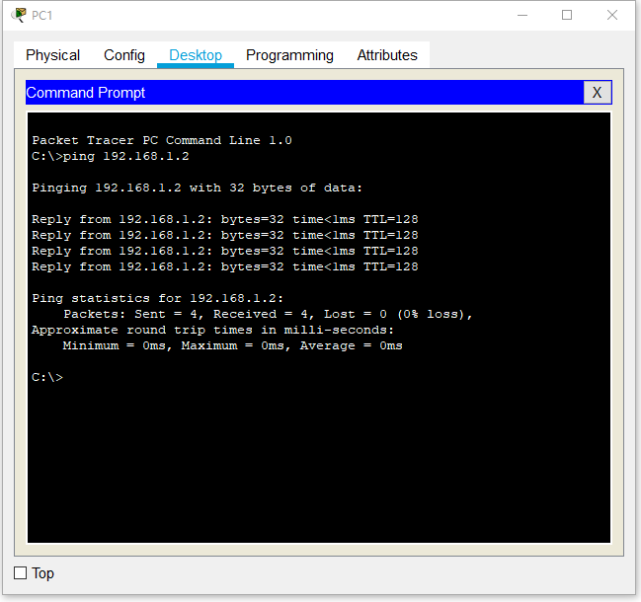
PC test
PC1 ping PC2

Slide 20
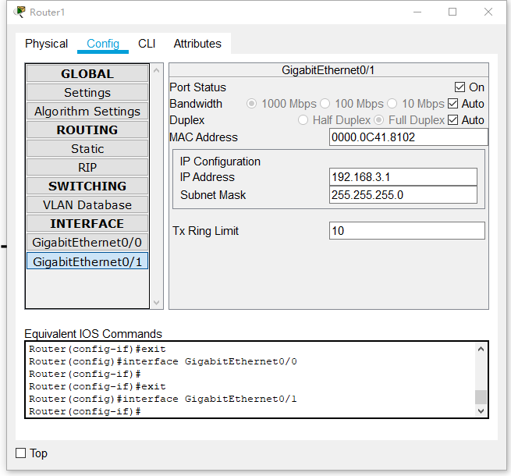
Router Basic Setup
Connect switch to router 1 and router 2:
configure the Ip of Gig0/0 of R1 and open Git0/0
configure the Ip of Gig0/1 of R1 and open Git0/1

Slide 21
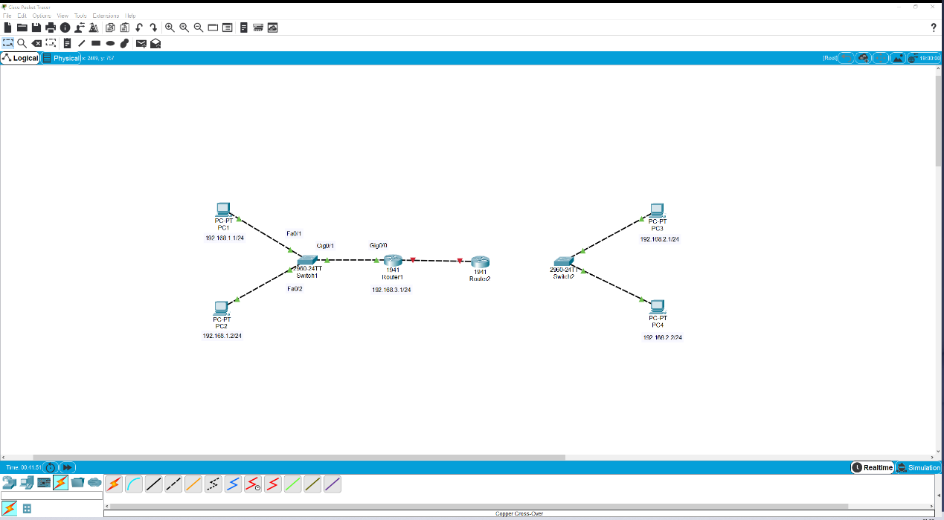
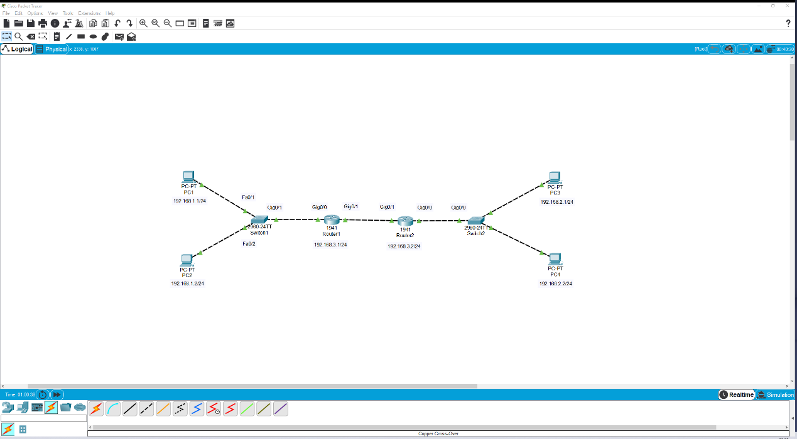
Topology is ready
Present State
The same can be obtained

Slide 22
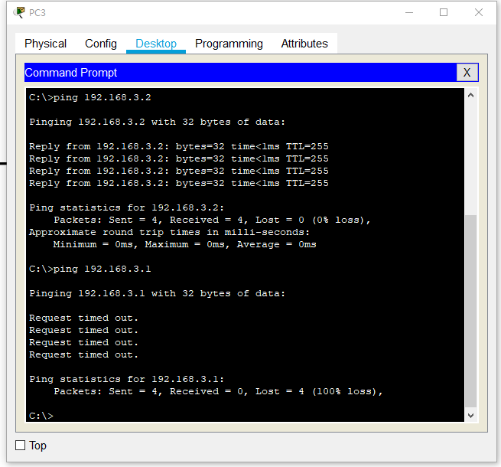
Test
PC3 ping PC1 fail...
What’s wrong?

Slide 23
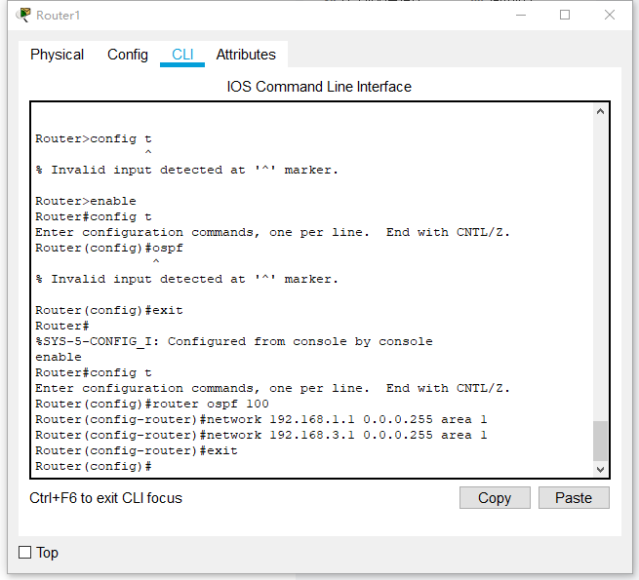
OSPF
R1
enable
config t
router ospf 100
network 192.168.1.0 0.0.0.255 area 1
network 192.168.3.0 0.0.0.255 area 1
exit

Slide 24
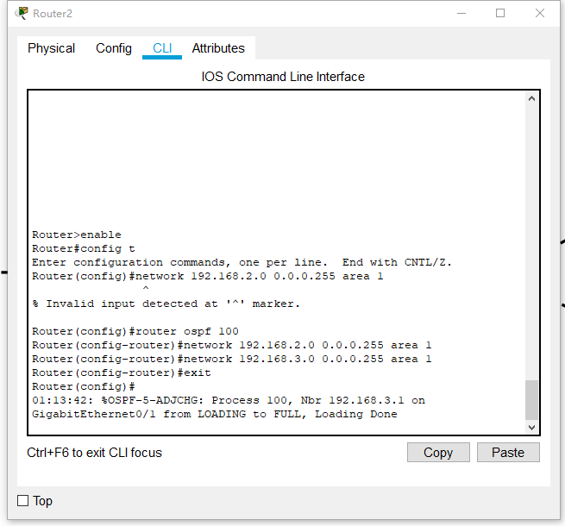
OSPF
R2
enable
config t
router ospf 100
network 192.168.2.0 0.0.0.255 area 1
network 192.168.3.0 0.0.0.255 area 1
exit

Slide 25
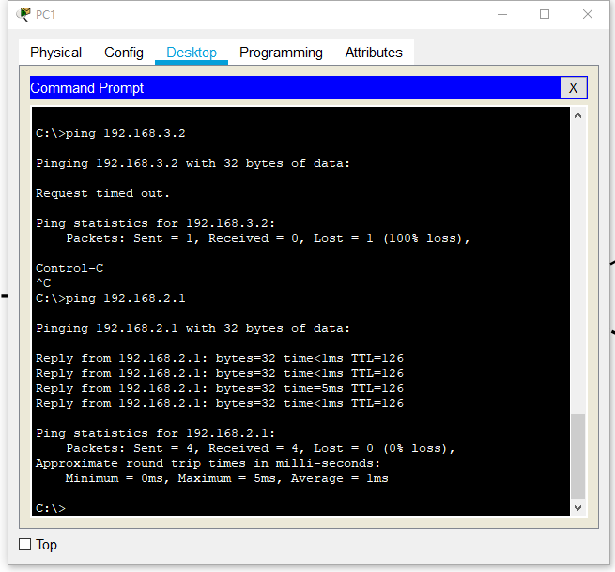
Test
PC1 ping PC3
success !

Slide 26
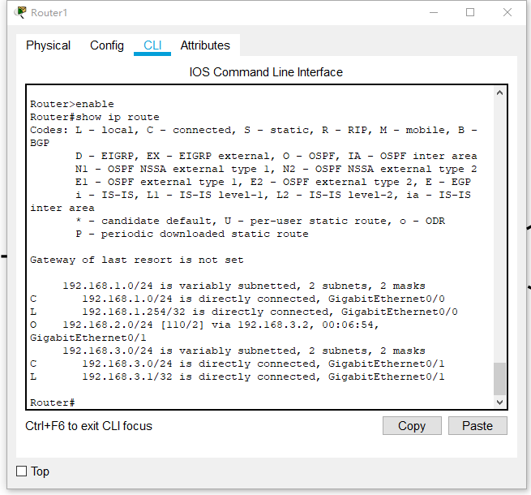
Routing Table
O: OSPF route
192.168.2.0/24: Destination network and subnet mask
via 192.168.3.2: Next-hop IP address
00:06:54: Time since the last update
GigabitEthernet0/1: Local router interface to use for this route

Slide 27
03
RIP vs. OSPF

Slide 28
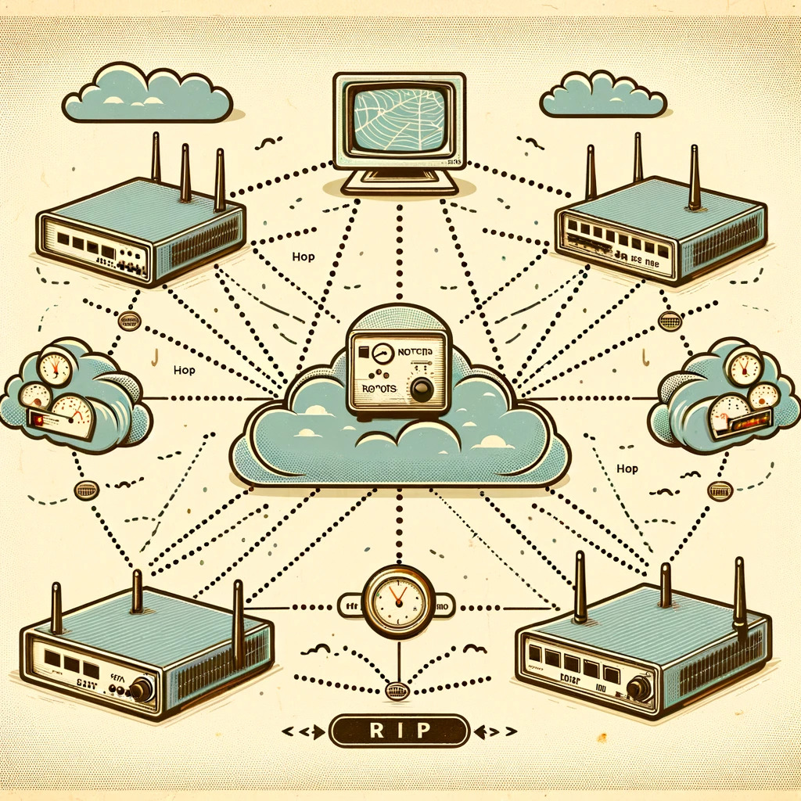
RIP
RIP, or Routing Information Protocol, is one of the oldest routing protocols. It's a distance-vector protocol that uses the number of hops a packet must pass through as its primary metric for selecting the best path.

Slide 29

OSPF
OSPF, or Open Shortest Path First, is a more sophisticated protocol. It's a link-state protocol that calculates the most efficient route for data packets based on the cost of the path, which is typically influenced by bandwidth.

Slide 30
RIP vs. OSPF
There are differences
Feature | RIP | OSPF
Type | Distance-vector | Link-state
Metric | Hop count (max 15) | Cost (bandwidth)
Convergence | Slow | Fast
Updates | Periodic full-table | Incremental LSAs
Algorithm | Bellman-Ford | Dijkstra
Scalability | Small networks | Large networks
Design | Flat | Hierarchical with areas
Configuration | Simple | More complex

Slide 31
RIP vs. OSPF
There are deficiencies
RIP
OSPF
Operation
periodic updates, based on Bellman-Ford algorithm
event-driven updates, based on Dijkstra's algorithm

Slide 32

RIP Implementation of
Bellman-Ford Algorithm
Bellman-Ford Algorithm
Algorithm in Action:
A distance-vector routing algorithm used by RIP to determine the best path to a network.
Calculates the shortest path based on the number of hops between nodes.
Each router calculates the distance to all reachable networks.
The distance metric is the number of hops.
Routes with over 15 hops are considered unreachable, preventing routing loops.
RIP's Usage:
Every RIP-enabled router uses Bellman-Ford to update its routing table.
Routers broadcast their routing table to neighbors every 30 seconds.

Slide 33

OSPF Implementation of
Dijkstra's Algorithm
Dijkstra's Algorithm
Algorithm in Action:
A link-state algorithm that calculates the shortest path tree for each route.
Utilizes network topology knowledge stored in the link-state database.
Begins at the router, adding the nearest node to the shortest path tree.
Continues adding the closest non-visited node until all nodes are included.
The cost metric considers factors like bandwidth to determine the shortest path.
OSPF's Usage:
OSPF routers construct a topological map of the network.
The map is then used to run Dijkstra's algorithm and find the shortest path to all networks.

Slide 34
RIP vs. OSPF
There are deficiencies
RIP
OSPF
Convergence
&
Efficiency
Slow convergence, can cause temporary loops.
Periodic full-table updates, less bandwidth efficient
Fast convergence, more stable network.
Incremental updates, more bandwidth efficient

Slide 35
P
Pros
Cons
Simplicity and ease of configuration.
Low resource usage.
Wide support across devices
Slow convergence and potential for routing loops.
Hop count limitation restricts network size.
Full routing table updates are bandwidth-intensive.
RIP
-

Slide 36
P
Pros
Cons
Quick adaptation to network
changes.
Scalable to large networks.
Efficient IP address usage
with VLSM/CIDR.
Complexity in configuration and management
Higher resource requirements
Need for careful area design and ABR configuration
OSPF
-

Slide 37
Question for Audiences

Slide 38
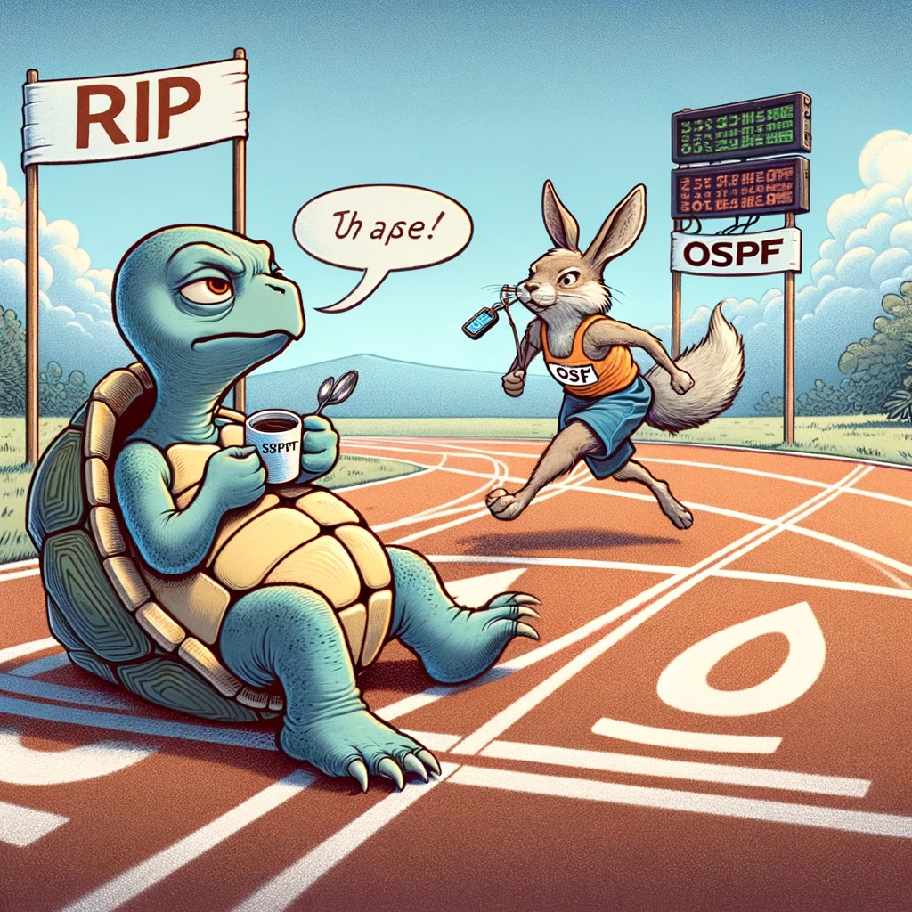
Question
If RIP and OSPF were in a race to update their routes, what would be the likely outcome? (Wrong Answer Only)
A) RIP would take a leisurely stroll and stop for a coffee, allowing OSPF to win with its faster pace.
B) OSPF would get lost counting hops and let RIP hop to the finish line first.
C) They'd both get disqualified for arguing over who has the better algorithm.
D) RIP would insist on using a map from the '90s, while OSPF zooms ahead with GPS navigation.

Slide 39
04
References

Slide 40
References
[1] https://blog.csdn.net/m0_72471315/article/details/131060888
[2] https://www.cisco.com/c/en/us/support/docs/ip/open-shortest-path-first-ospf/7039-1.html
[3] https://community.fs.com/article/rip-vs-ospf-what-is-the-difference.html
[4] https://blog.csdn.net/qq_42437085/article/details/106733432

Slide 41
Thanks
THANK YOU FOR WATCHING
Group 14
2023.11
演示文稿是一种实用的工具，可以是演示，演讲，报告等

